Slide 1
NETWORK LAYER & CONCEPT OF IP -by Hitesh Nautiyal

Slide 2
Network Layer :-
The network layer is a portion of online communications that allows for the connection and transfer of data packets between different devices or networks.
The network layer is the third level (Layer 3) of the Open Systems Interconnection Model (OSI Model) and the layer that provides data routing paths for network communication. Data is transferred to the receiving device in the form of packets via logical network paths in an ordered format controlled by the network layer.
Logical connection setup, data forwarding, routing and delivery error reporting are the network layer’s primary responsibilities. Layer 3 can be either able to support connection-oriented or connectionless networks (but not both of them at the same time).

Slide 3
Functions of Network Layer :-
When data is to be sent, the network layer accepts data from the transport layer above, divides and encapsulates it into packets and sends it to the data link layer. The reverse procedure is done during receiving data.
The network layer is responsible for routing packets from the source host to the destination host. The routes can be based upon static tables that are rarely changed; or they can be automatically updated depending upon network conditions.
Many networks are partitioned into sub-networks or subnets. The network layer controls the operations of the subnets. Network devices called routers operate in this layer to forward packets between the subnets or the different networks.
The lower layers assign the physical address locally. When the data packets are routed to remote locations, a logical addressing scheme is required to differentiate the source system and the destination system. This is provided by the network layer.
This layer also provides mechanisms for congestion control, in situations when too many packets overload the subnets.
The network layer tackles issues like transmission delays, transmission time, avoidance of jitters etc.

Slide 4
Concept of IP :-
An internet protocol (IP) address allows computers to send and receive information.
An IP address allows information to be sent and received by the correct parties, which means it can also be used to track down a user's physical location in some instances.
IP addresses are generated through a hierarchical system involving the IANA, RIRs and ISPs.
Common IP security threats include hijacking, blacklisting, and DDoS attacks.
Users can protect their IP address by using firewalls, keeping software updated, using VPNs, and enabling two-factor authentication.
Different types of IP addresses include public and private, with public IP addresses being either dynamic or static.

Slide 5
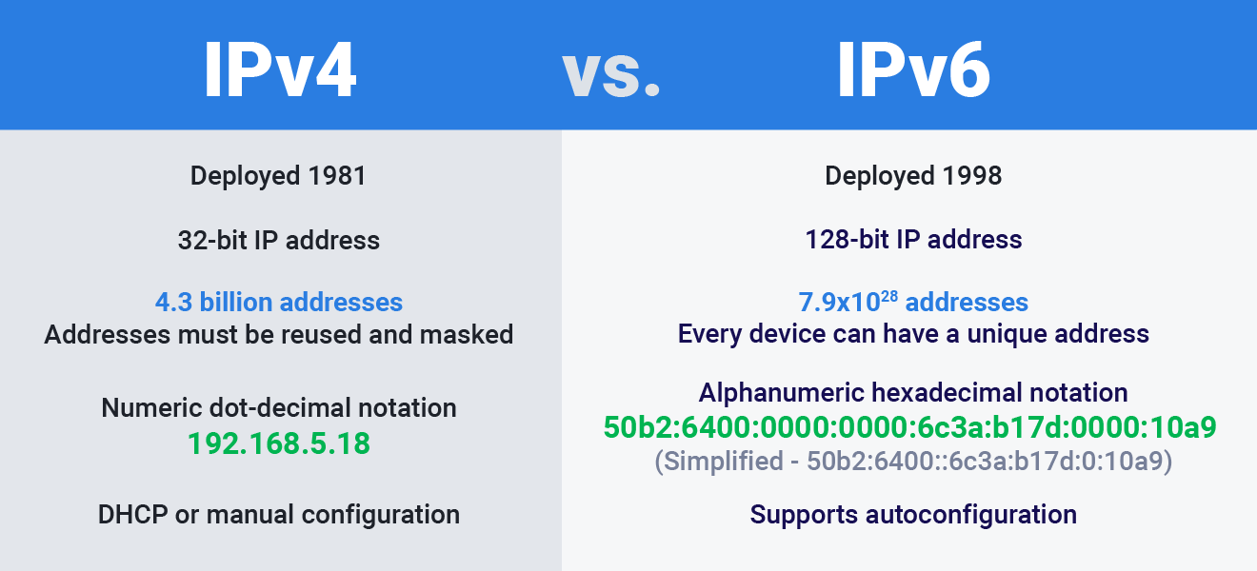
IPv4 and IPv6 :-

